Slide 1
Nifty Node Network
Rushad Antia

Slide 2
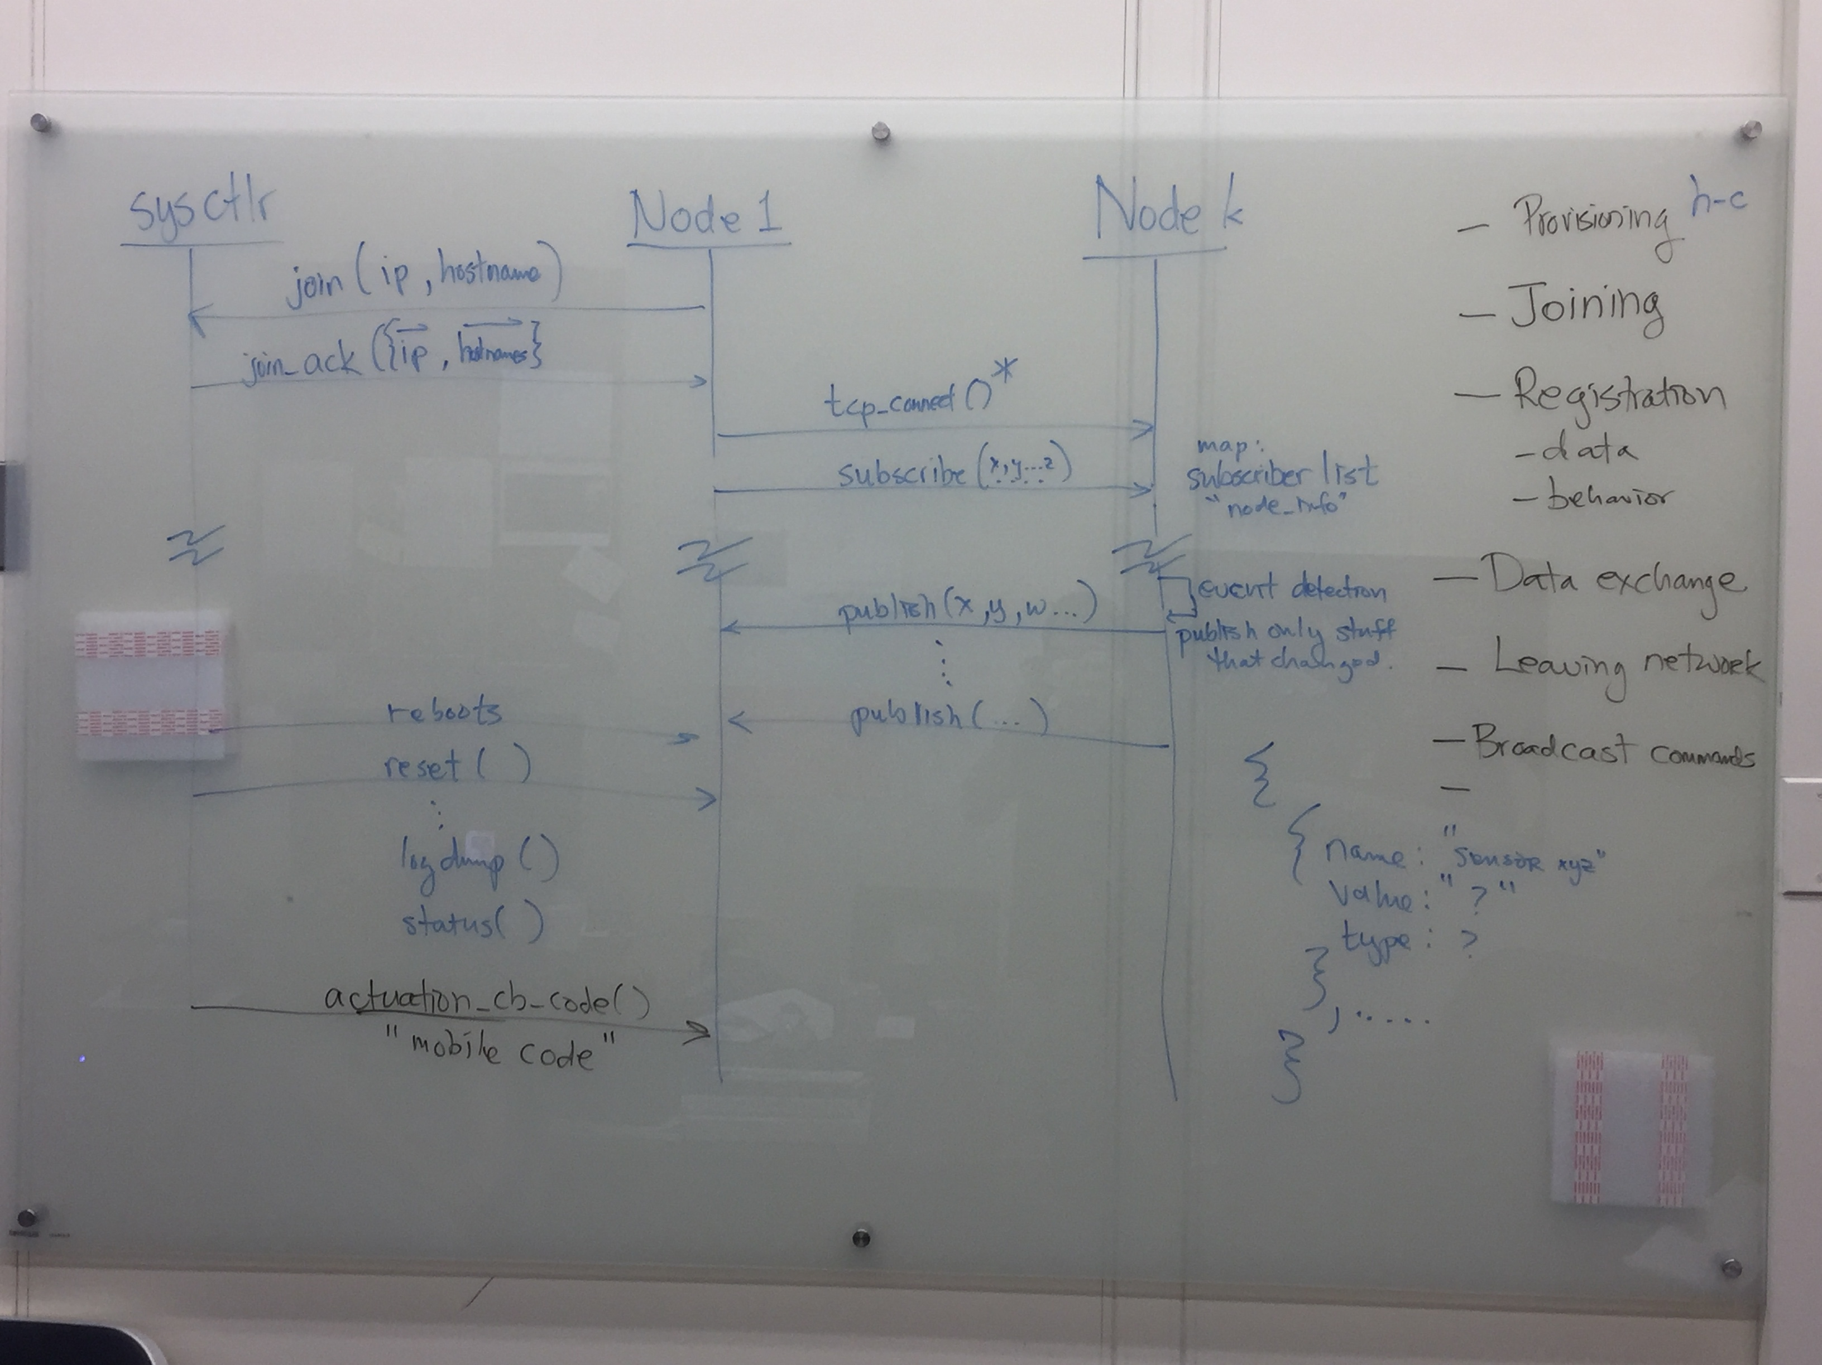

Slide 3
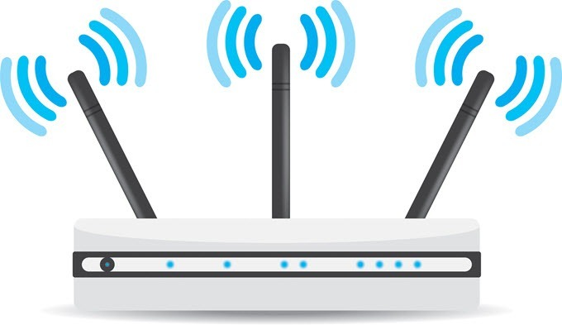
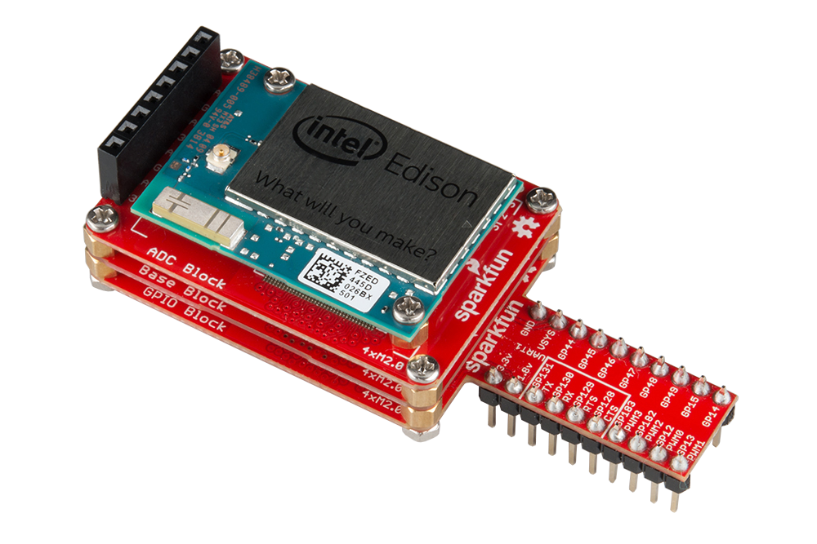

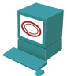
“Master Node”
Used for discovery of nodes on the network
Runs server at static ip
Nodes connect and exchange information (hostname, ip, sensors)
Holds table of connected devices
Ability to reboot, reset, and upload code to nodes
Node requests information about the network
MN responds by sending a list of connected devices to that node
edison01
10.20.0.10
RJ-45
edison02
10.20.0.11
Node Table:
edison01:10.20.0.10
edison02:10.20.0.11
edison03:10.20.0.12
edison03
10.20.0.12

Slide 4
Slave Node (Provisioning)
Creates object to connect to the Master Node
User inputs list of sensors that the node has
User starts the master node connection

Slide 5

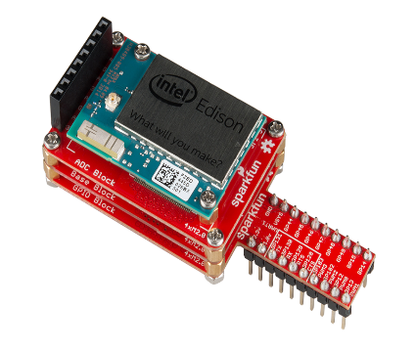
Slave Node (joining)
Give me connected node info!!
Connects to master node
Requests other connected nodes information
Makes connections to those nodes
Requests from those nodes for their sensor id’s
Makes requests to those nodes to subscribe to the topics it wants
Here you go
Let me connect to these guys*
*All nodes connected to each other

